Slide 1

Title:
Simulating an airport traffic control operation

Slide 2
M e m b e r s
Name:
ID:
Ghaida alarfaj | 219009389
Noura almosened | 219010636
Sara Almudairs | 219022773
Zahra alabbad | 219032482
.

Slide 3

Introduction

Slide 4


This is project on Simulating An Airport Operation using modern c++ programming. Since airports have become very important nowadays, and airplanes are used on a daily basis in all countries. However, there are too many problems that occur at airports, especially if the airport is small and there is only one runway. Example of problems is, There could be a collision between planes, one plane wanting to land and the another wanting to take off at the same time. Therefore, there will be a huge crowed at the runway. Because of these problems, we decided to design this project. So, the purpose of this project is to control the traffic operation on the airport

Slide 5


Problem statement
.

Slide 6


The airport has one runway, the plane comes at random instants of time, there is priority for landing planes, The take off planes still wait more time until there’re no more landing planes, there is a maximum number of planes that can wait

Slide 7

Data structure used for the solution and why?
Consultation Hours
4 PM to 6 PM

Slide 8
The main important thing in this program is : the arriving airplanes and departing airplanes must use the same runway. For that reason, it should be allocated to the airplanes that has been waiting the longest amount of time. So, the appropriate structure for this program is queue because Queue use FIFO method, but since we want to use this runway more than once we decided to use ” CURCULAR QUEUE ”.

Slide 9
This simulation model program help to avoid congestion issues consist for the landing and take off planes, the main idea is to give the plane which has to landing more priority than the take of plane There is also a maximum number of plan that will landing or take off and if it reach this point the airport will refuse the new plane
conclusion

Slide 10
Looking at the final output for the average waiting time, we notice that the waiting time for the takeoff is times more than the landing, which’s due always giving the priority to landing.
 | From the total planes processed, planes will only get accepted or refused. Then the accepted will eventually land/ take off successfully after waiting enough time in the queue. Meaning the airport will 100% process all the airplanes.
Despite having one runway, the program process only one plane at a time, so there’s no collision between the airplanes
Results and discussion

Slide 11
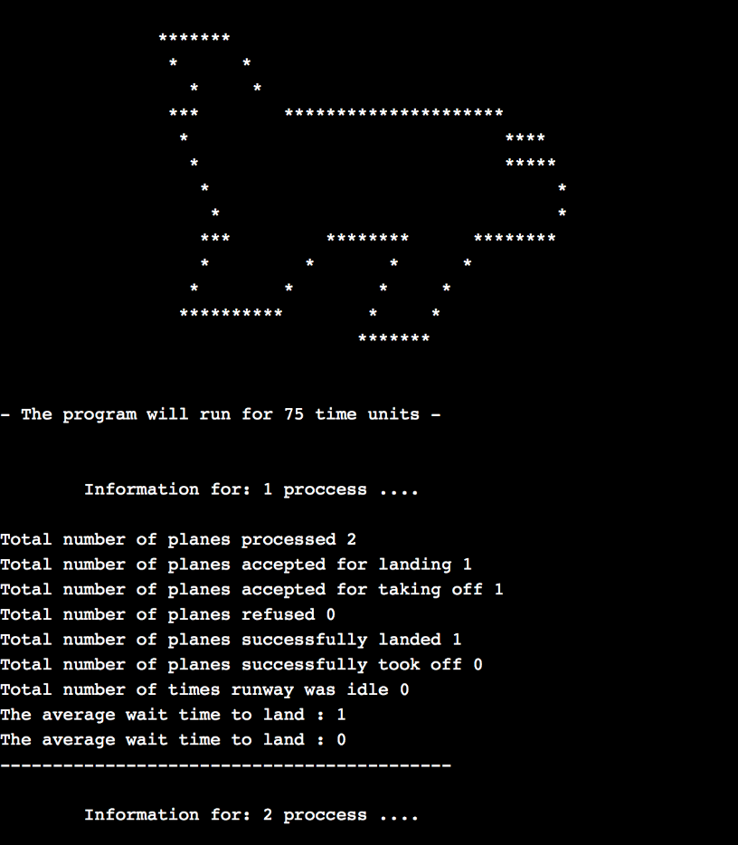
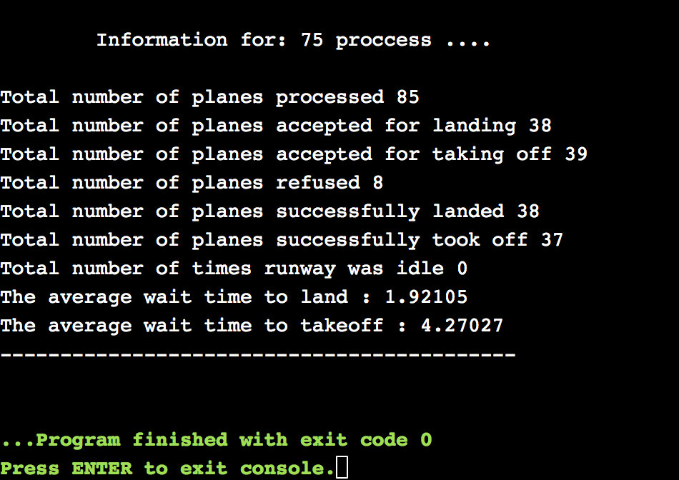
Output:
.

